Slide 1
Welcome to Sixth Grade

Slide 2
Why are You Here?
I am here to guide you to achieve what you want to achieve this year.
I am here to bring greatness out of you
I am here to make learning fun and exciting!
“ A master can tell you what he expects of you. A teacher, though awakens your own expectations.”

Slide 3
What do you Hope to Accomplish This Year?
Teach a love of learning.
That my students realize that they are more capable than they even thought.
Master 6th Grade math and science standards
Prepare you for 7th grade.

Slide 4
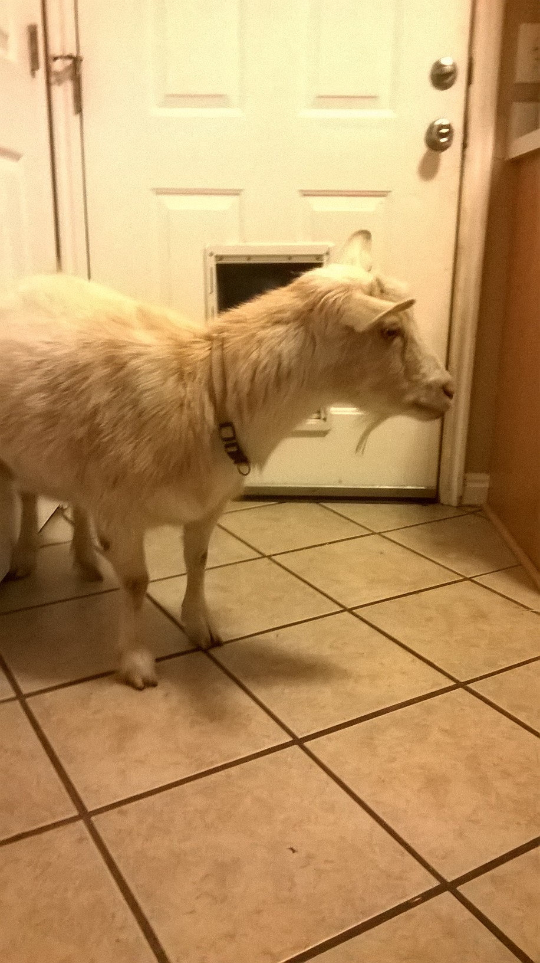
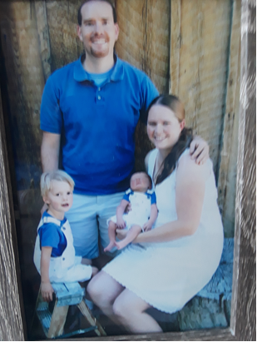
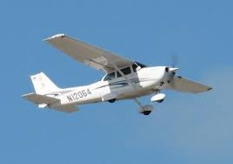
I love to teach and have been teaching for 8 years.
I live in Lake Point Utah with:
2 turkeys, 6 chickens, 2 sheep, and 4 ducks.
My Family
I am a Private Pilot!

Slide 5
What we will be learning
An outline of the core standards and objectives for sixth grade are located on the USOE website. These courses include math, language arts, science, social studies, physical education, art, and music. The Core Curriculum represents those standards of learning that are essential for all students. It can be found at www.uen.org/core

Slide 6
Daily Schedule Monday-Thursday
Art: Thursday 2:15-2:55
8:15-9:45 Frank H.R. Math P.E.: Tuesday 10:00-10:45
9:45-10:00 Recess
10:00-11:50 Gygi’s L.A.
11:50-12:20 Lunch
12:20-1:15 Gygi’s Social Studies
1:15-1:30 Recess
1:30-2:55 Science

Slide 7
Friday’s Schedule
8:15-9:45 H.R. Math and Science
9:45-10:00 Recess
10:00-11:50 Gygi’s L.A. and Social Studies
11:50-12:20 Lunch
12:20-12:50 Social Skills or Face Time Friday

Slide 8
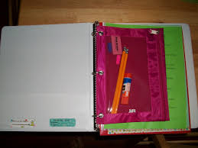
What Can We Bring To Class?
Water Bottle
Binder with folders and necessities. We will have classroom community supplies.

Slide 9
Homework and Assignments
HOMEWORK
*ELA = read 30 minutes every night
*Math = work that is not finished and 15 minutes of practice everyday
*Science=work that is not finished
GRADES
*Students will take responsibility in their learning. This is their job! Grades will measure the students’ ability to apply the skills and knowledge learned from the unit of study. Students can always redo low scores and missing work may be made up. We expect our students to take ownership in their learning.

Slide 10
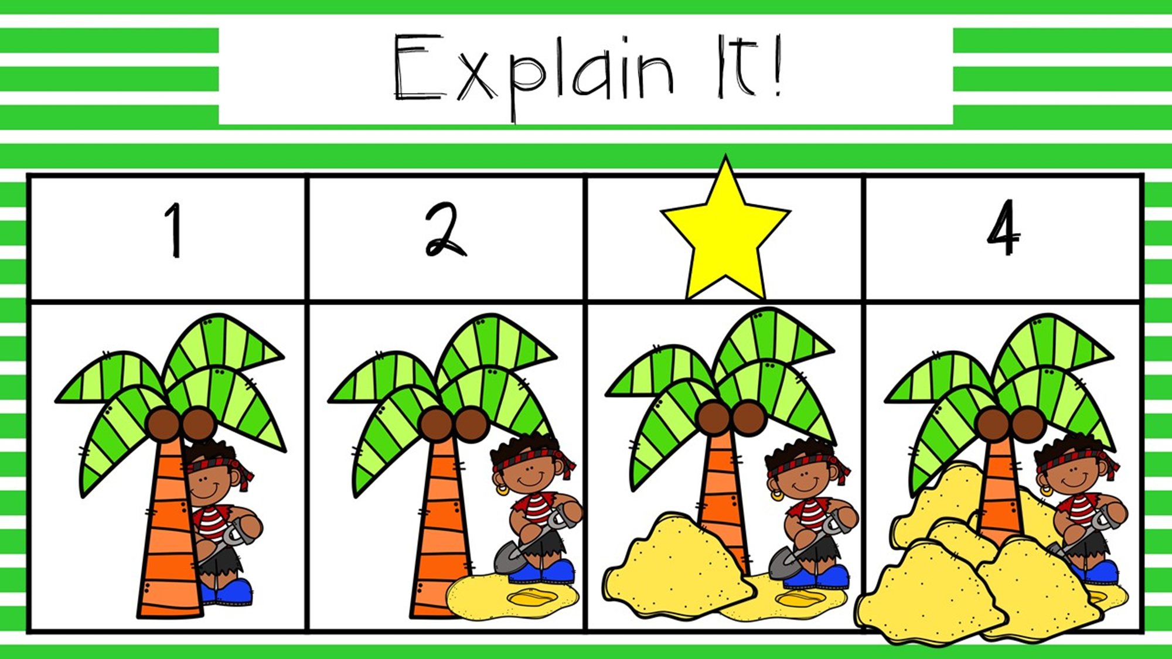
Proficiency Grading
4 Above Proficient
3 Proficient
2 Approaching Proficient
1Below Proficient

Slide 11
Proficiency Based Grading
There is no extra-credit in academic grades.
Participation, attendance, and compliance are included in the citizenship grade not academics.
Students are given opportunities to provide mastery for each concept.
Teachers use multiple lines of evidence to determine a student’s level of proficiency.
Homework is meaningful practice which requires time and effort outside of school, it is not scored.

Slide 12
Food and Drinks
Water is allowed at all times
No Food
No candy during class
No gum unless earned through rewards

Slide 13
Behavior and Discipline Policy
We are using ClassDojo to communicate with you this year.
You can download the app to get daily student behavior updates as well as classroom updates.

Slide 14
Student Led Conferences
Students focus on their achievements and challenges.
Students celebrate successes and make plans for future growth.
Provides an opportunity for your child to improve communication skills and discuss their own learning process.
Schedule: 3 appointments per slot

Slide 15
Website
Mr. Franks: http://mrfrankrosecrest.weebly.com/
Google Classroom https://classroom.google.com
Think Central https://www-k6.thinkcentral.com/ePC/start.do?orgID=01065041

Slide 16
I AM ALWAYS AVAIBLE
Come on in
Email me rwfrank@graniteschools.org
Give me a call 385-887-1097

